Slide 1
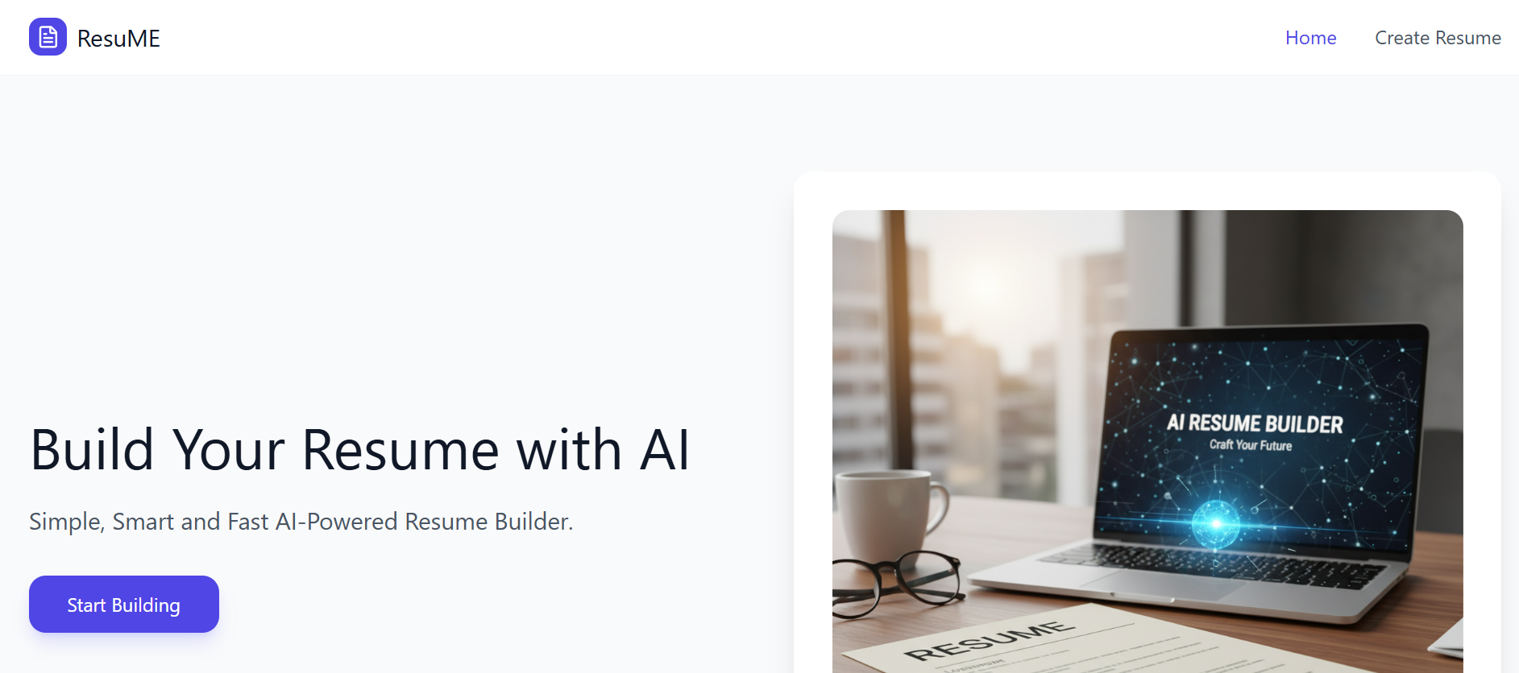
ResuMe An AI-Powered Resume Builder Web Application
Developed by: Yash Jaiswal Megha Verma Vidushi Pandey Krrish Verma B.Tech – CSE-R

Slide 2
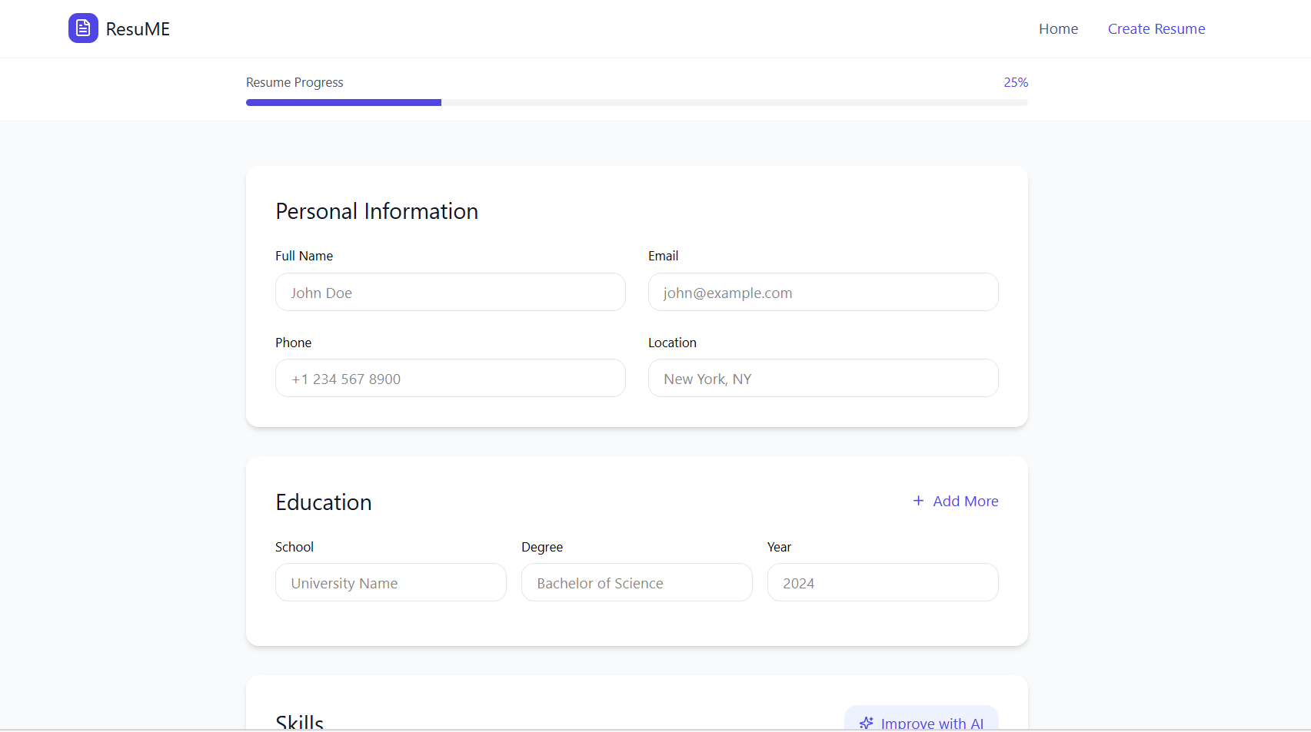
Introduction
Creating a professional resume is important for job applications. Many students struggle with formatting and design.
The ResuMe is a web application that helps users:
Create resumes easily
Enter personal and professional details
Generate a well-structured resume format
Use your personalized resume

Slide 3
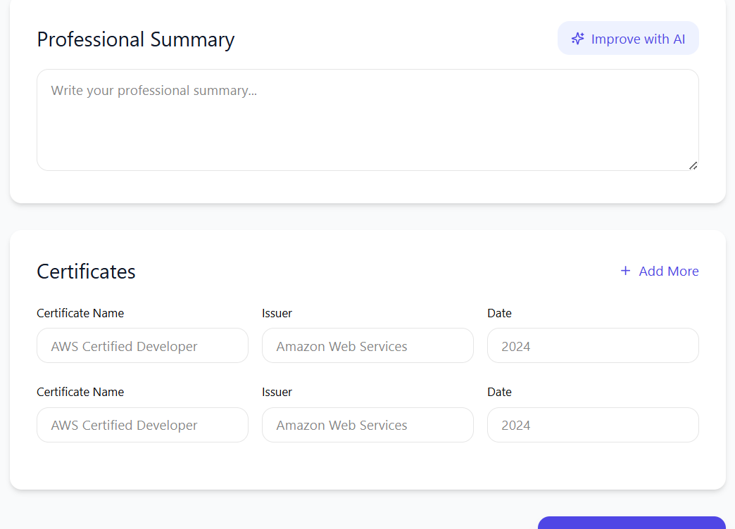
Problem Statement
Many students and job seekers face problems such as:
Difficulty designing resumes
Lack of proper formatting knowledge
Time-consuming manual editing
Confusion about what information to include
3

Slide 4
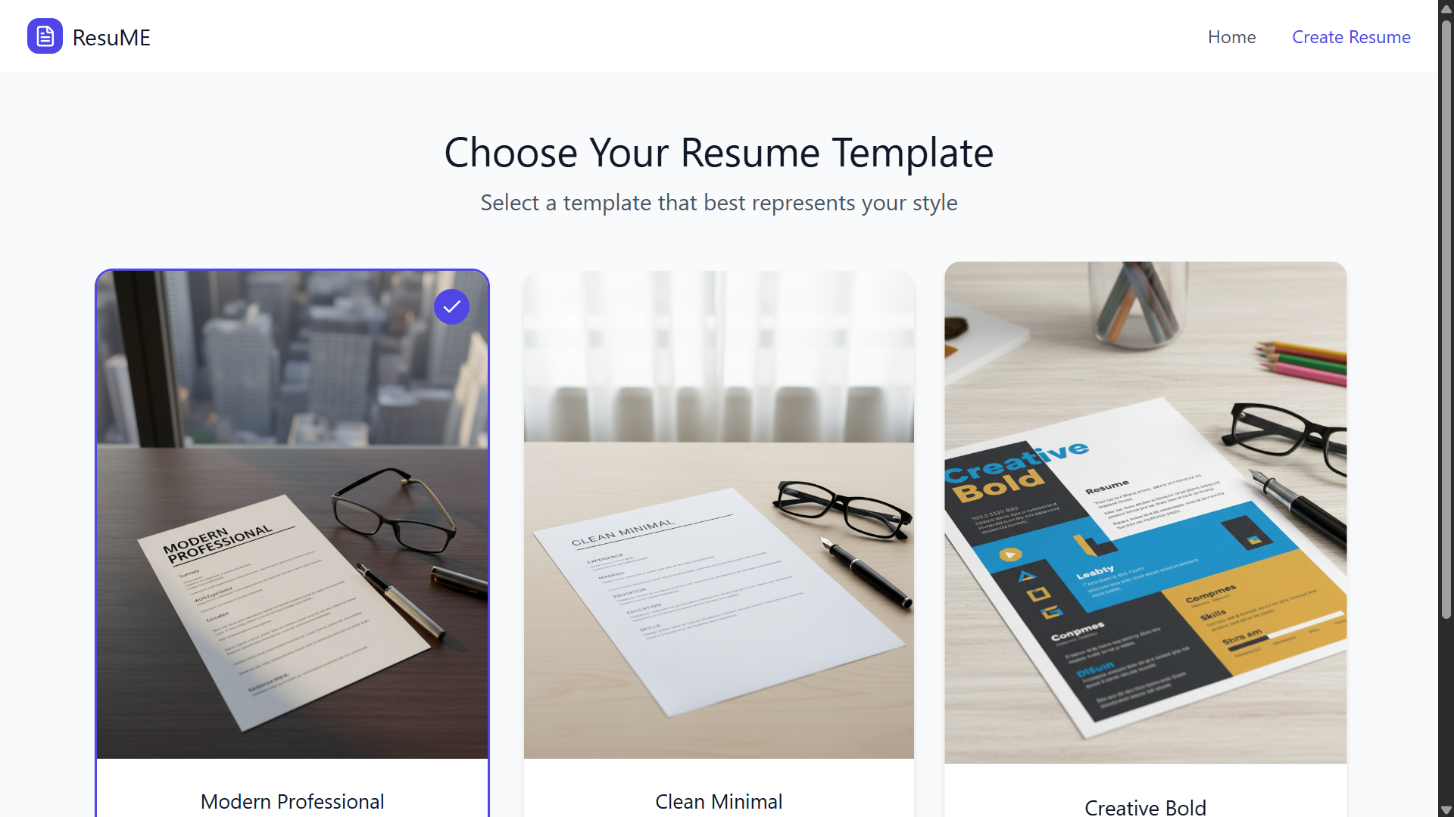
Objectives of the Project
The main objectives of the project are:
To develop an easy-to-use resume builder
To allow users to enter their information in a structured format
To automatically generate a professional resume layout
To simplify resume creation for students and freshers

Slide 5
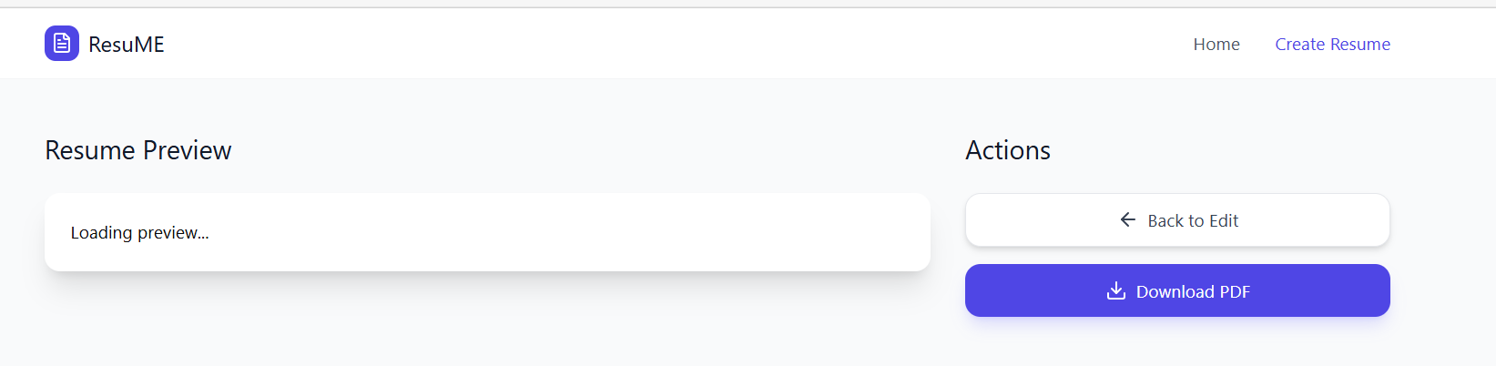
Technologies Used
Frontend:
React: for building interactive UI
CSS: for styling and layout
Development Tools:
Visual Studio Code
Node.js
Vite
Github
5

Slide 6
System Architecture
The system mainly consists of two parts:
Frontend
User interface
Form to enter resume details
Resume preview display
Backend (Future Implementation)
Data storage
Resume download functionality
User authentication
Currently, the frontend is implemented.
6

Slide 7

Key features of the Resume Builder project
1.
2.
3.
4.
5.
User-friendly interface
Simple form to enter resume details
Real-time resume preview
Clean and professional resume layout
Responsive design
7

Slide 8
Working of the Application
The working process of the application:
User opens the Resume Builder website
User enters personal details, education, skills, etc.
The system organizes the data automatically
Resume preview is generated on the screen
Final resume format is displayed
8

Slide 9
Implementation (Frontend)
The frontend of the application is built using React components.
Main components include:
Form components for user input
Resume display component
Styling using CSS
React helps in creating dynamic and reusable UI components.

Slide 10
Future Enhancements
Some improvements that can be added in the future:
Backend integration for data storage
Resume download as PDF
Multiple resume templates
User login and profile saving
AI-based resume suggestions

Slide 11
Conclusion
The Resume Builder project provides a simple platform to create professional resumes quickly.
The current implementation focuses on the frontend interface using React.
With further development such as backend integration and additional features, the application can become a complete resume generation tool.

